Slide 1

SonART
«Every sound tells a story. We make sure it’s seen»

Slide 2
Art VS AI

Slide 3
Art vs AI

Slide 4
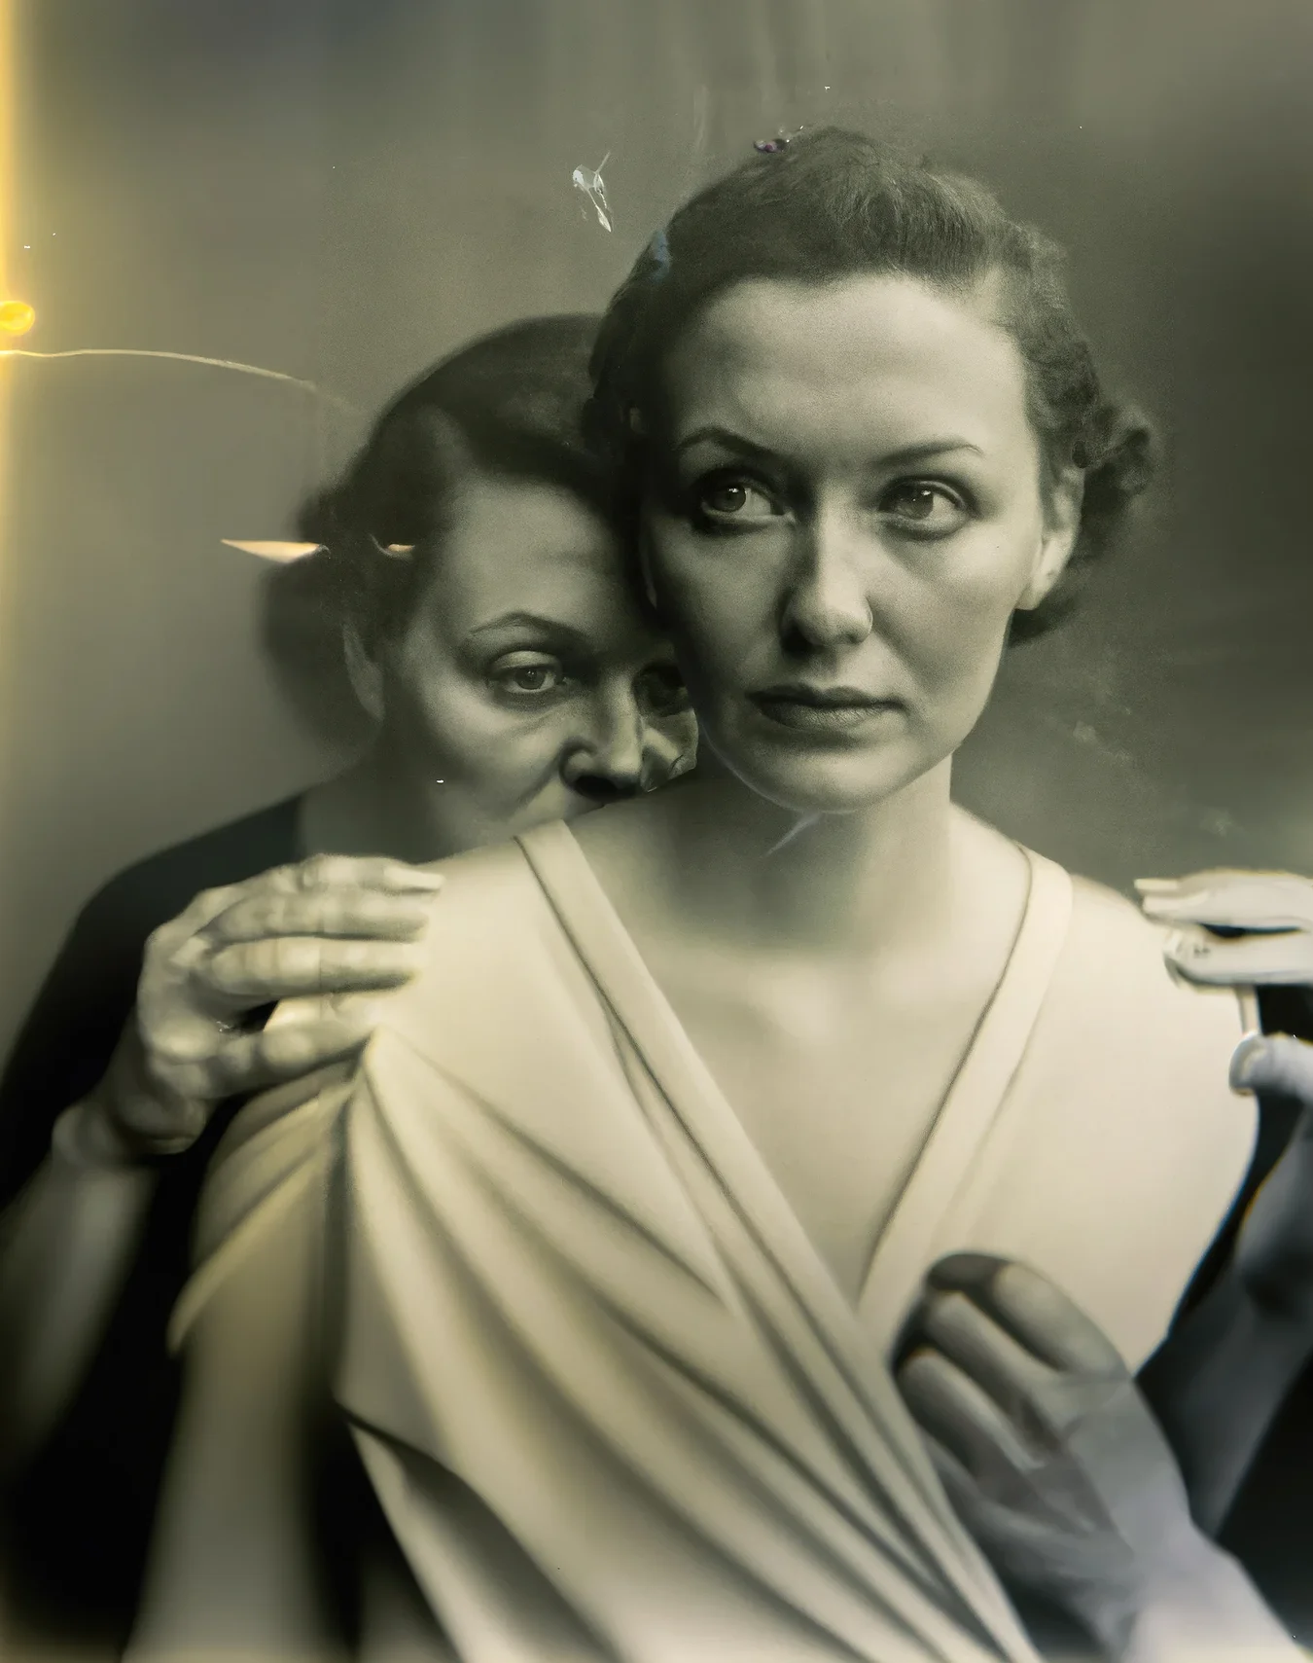
Art vs AI

Slide 5
Art vs AI

Slide 6
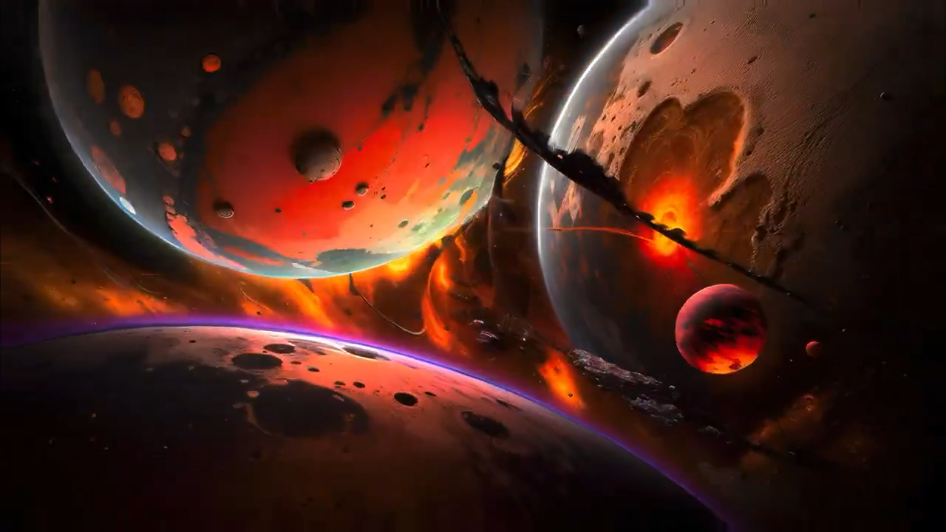
Art vs AI

Slide 7
Art vs AI

Slide 8
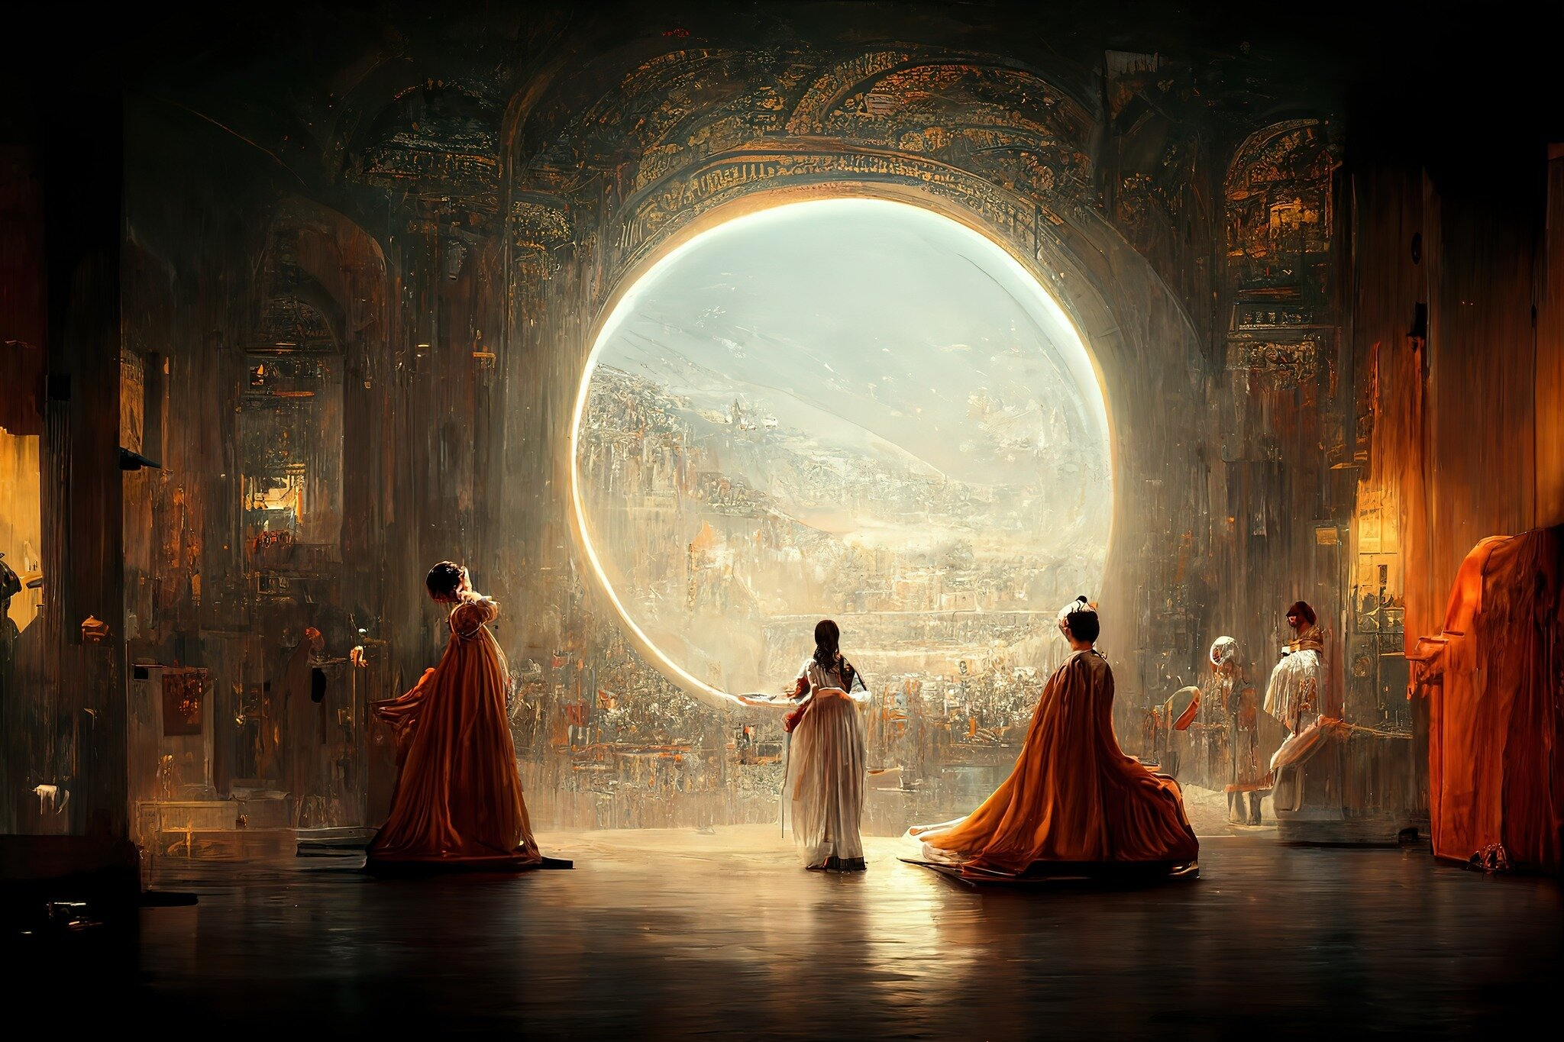
Art vs AI

Slide 9
Art vs AI

Slide 10

Art vs AI

Slide 11
Art vs AI

Slide 12
What can we give?

Slide 13
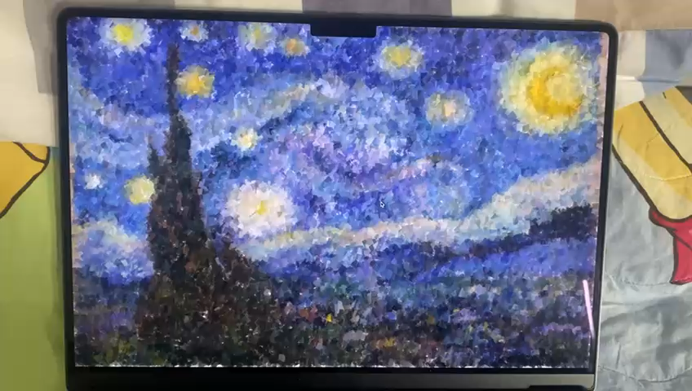
What can we give?

Slide 14
What can we give?
SonART is an application designed to help people with limited resources bring their performances to life, enhancing them through an original technology.
Primarily designed to accompany theatrical performances

Slide 15
Why this way?

Slide 16
Why this way?

Slide 17
Why this way?
It combines the worlds of audio and visuals in an original way
It doesn't replace us, but it helps us create
Easy to use and free of charge
Update the visuals whenever you want

Slide 18
Block Diagram

Slide 19
Block Diagram

Slide 20




Block Diagram
Audio upload
Audio Classification
Images Generation
Display audio and images

Slide 21
Block Diagram

Slide 22
Block Diagram

Slide 23
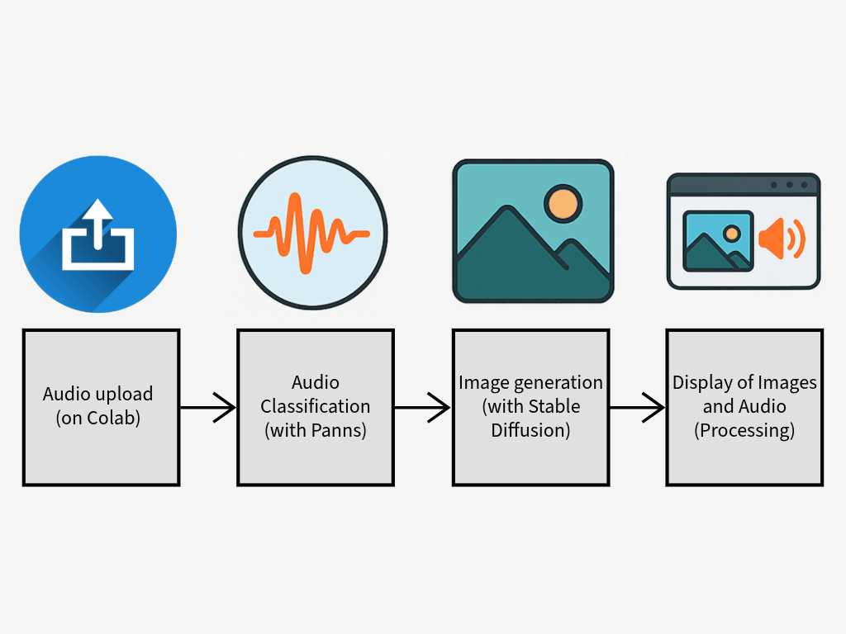
Block Diagram

Slide 24
Block Diagram

Slide 25
Audio Classification

Slide 26
Audio Classification

Slide 27
Audio Classification
Pre-trained convolutional neural network

Slide 28
Audio Classification
Pre-trained convolutional neural network
Challenges:
Accuracy
Labels in training datasets

Slide 29
Audio Classification
Pre-trained convolutional neural network
Challenges:
Accuracy
Labels in training datasets
Solutions:
Trade off between responsiveness and accuracy
Probability threshold
Label management

Slide 30
Images Generation

Slide 31
Images Generation

Slide 32
Images Generation
Diffusion-based text-to-image generative model

Slide 33
Images Generation
Diffusion-based text-to-image generative model
Challenges:
Time
Coherence between images

Slide 34
Images Generation
Diffusion-based text-to-image generative model
Challenges:
Time
Coherence between images
Solutions:
Colab GPU
Background + style

Slide 35
Display audio and images

Slide 36
Display audio and images

Slide 37
Display audio and images
Processing script

Slide 38
Display audio and images
Processing script
Challenges:
Smooth transitions
Sync with audio
Connection with colab

Slide 39
Display audio and images
Processing script
Challenges:
Smooth transitions
Sync with audio
Connection with colab
Solutions:
Timestamps
ngrok

Slide 40
Other ideas

Slide 41
Other ideas

Slide 42
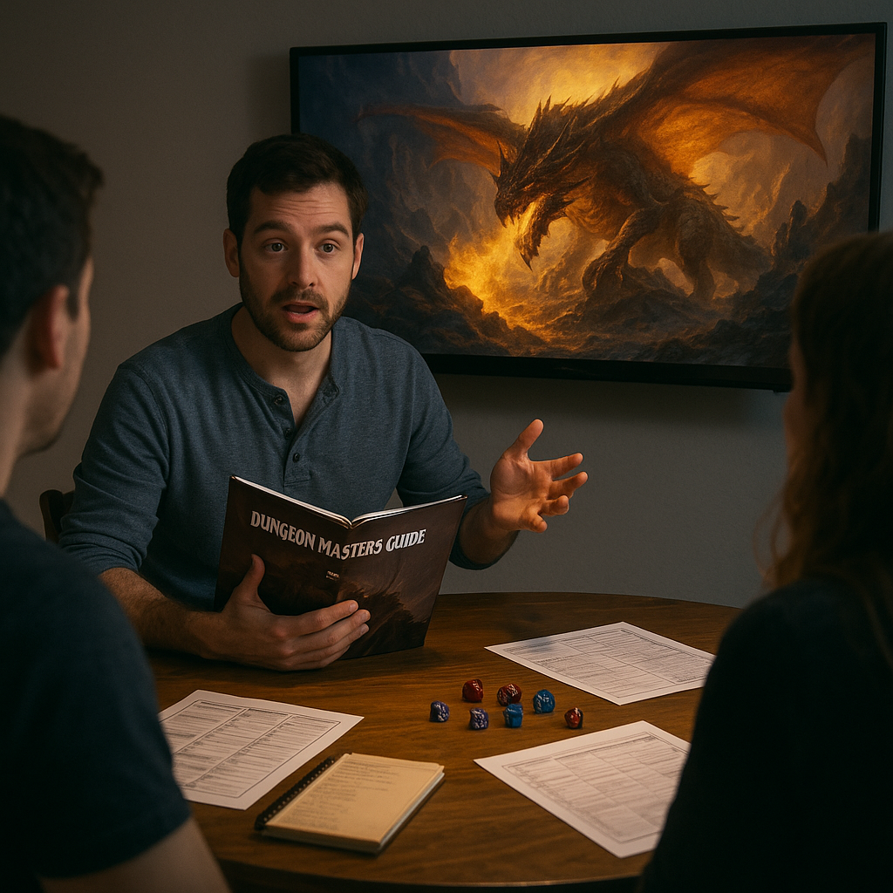
Other ideas

Slide 43
Other ideas

Slide 44
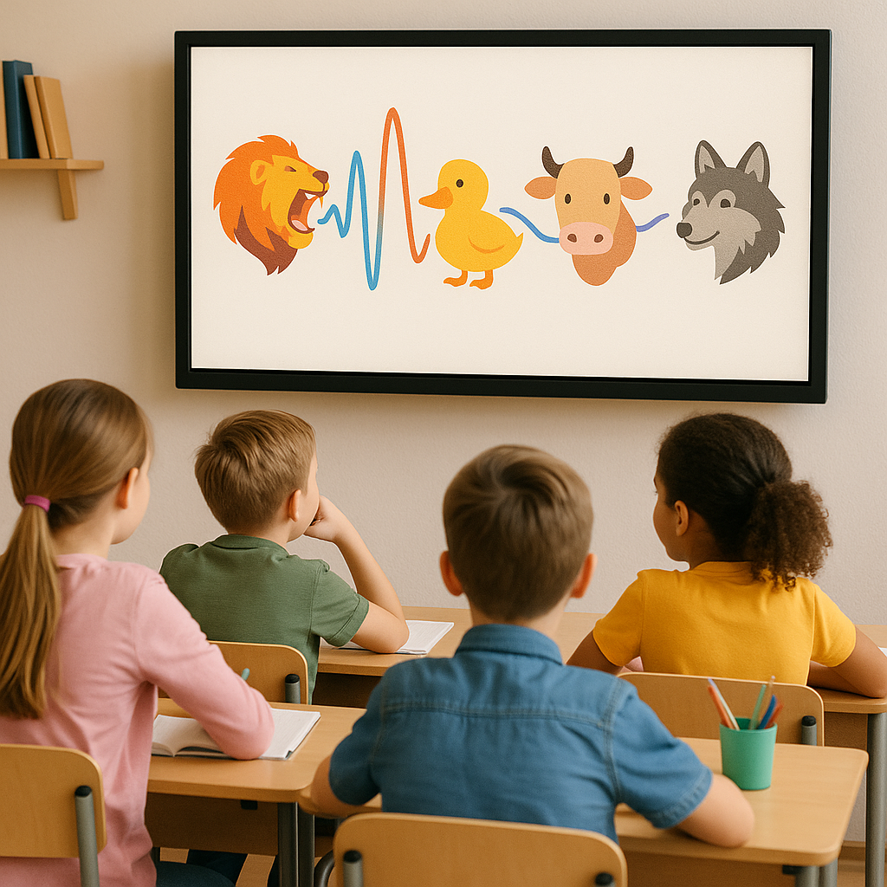
Other ideas

Slide 45
Other ideas

Slide 46
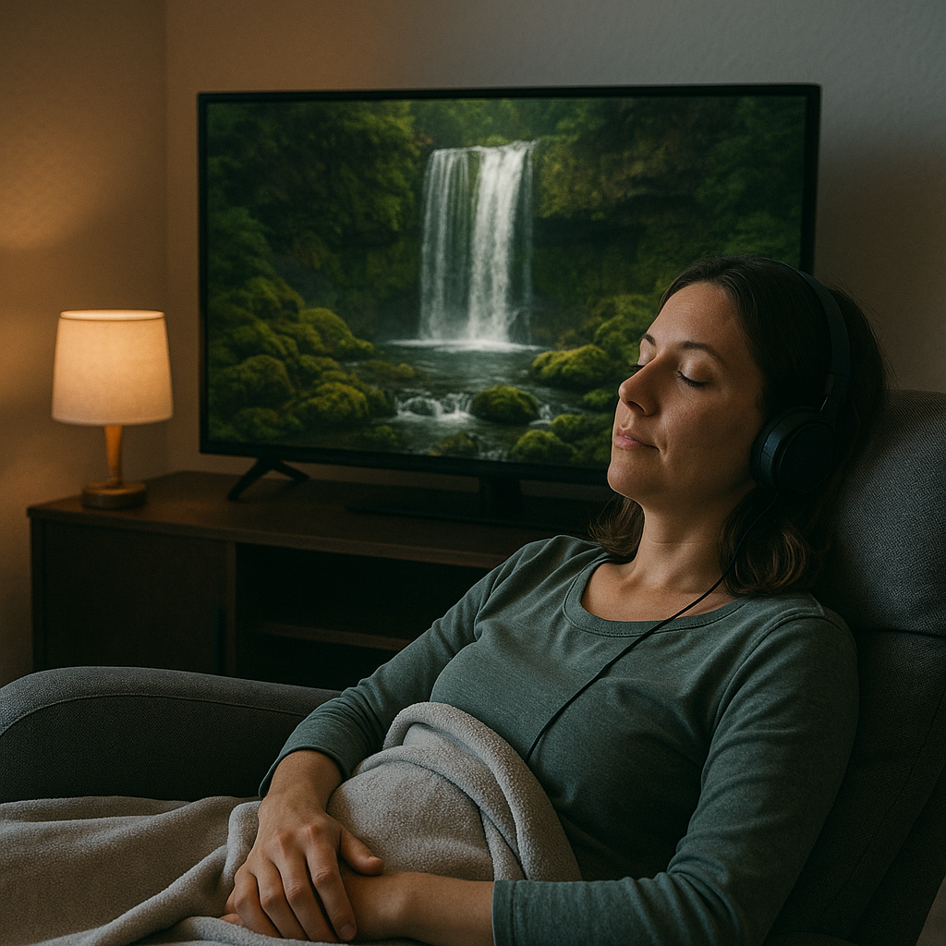
Other ideas

Slide 47
Other ideas

Slide 48
Thank you!
cHIARA AURIEMMA
mATTEO BENZO
ANNA fUSARI
dIEGO PINI

